Slide 1
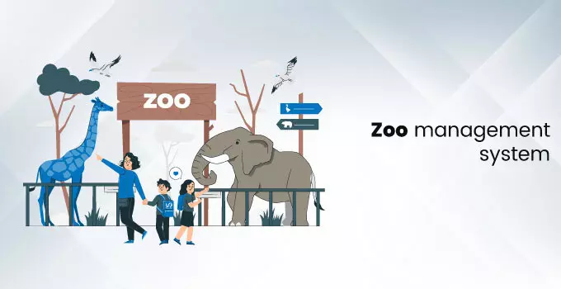

Slide 2
Client Information:
Client: Sri Chamarajendra Zoological Gardens is a zoo located in Mysore, Established in 1892.It is expanded over 75 acres of land.
Zoo was named after founder Sri Chamarajendra , Now the zoo is controlled by Zoo Authority of Karnataka.
The zoo is housing more than 1450 animals belonging to 160 species represents more than 25 countries.

Slide 3
Project business need
It helps the zoo management in keeping track of the animals.
Saves the time and manages the data of the visitors.
It makes the ticketing process easier and also manages the data of the visitors.
Improves the customer services.
Improves the management of the animals.
The zoo management can keep the track of people who have visited the zoo in past.

Slide 4
Project Architecture:
Animal
Details
Normal
Ticket
Reports
Foreigners
Ticket
Search
Manage Type
Ticket

Slide 5
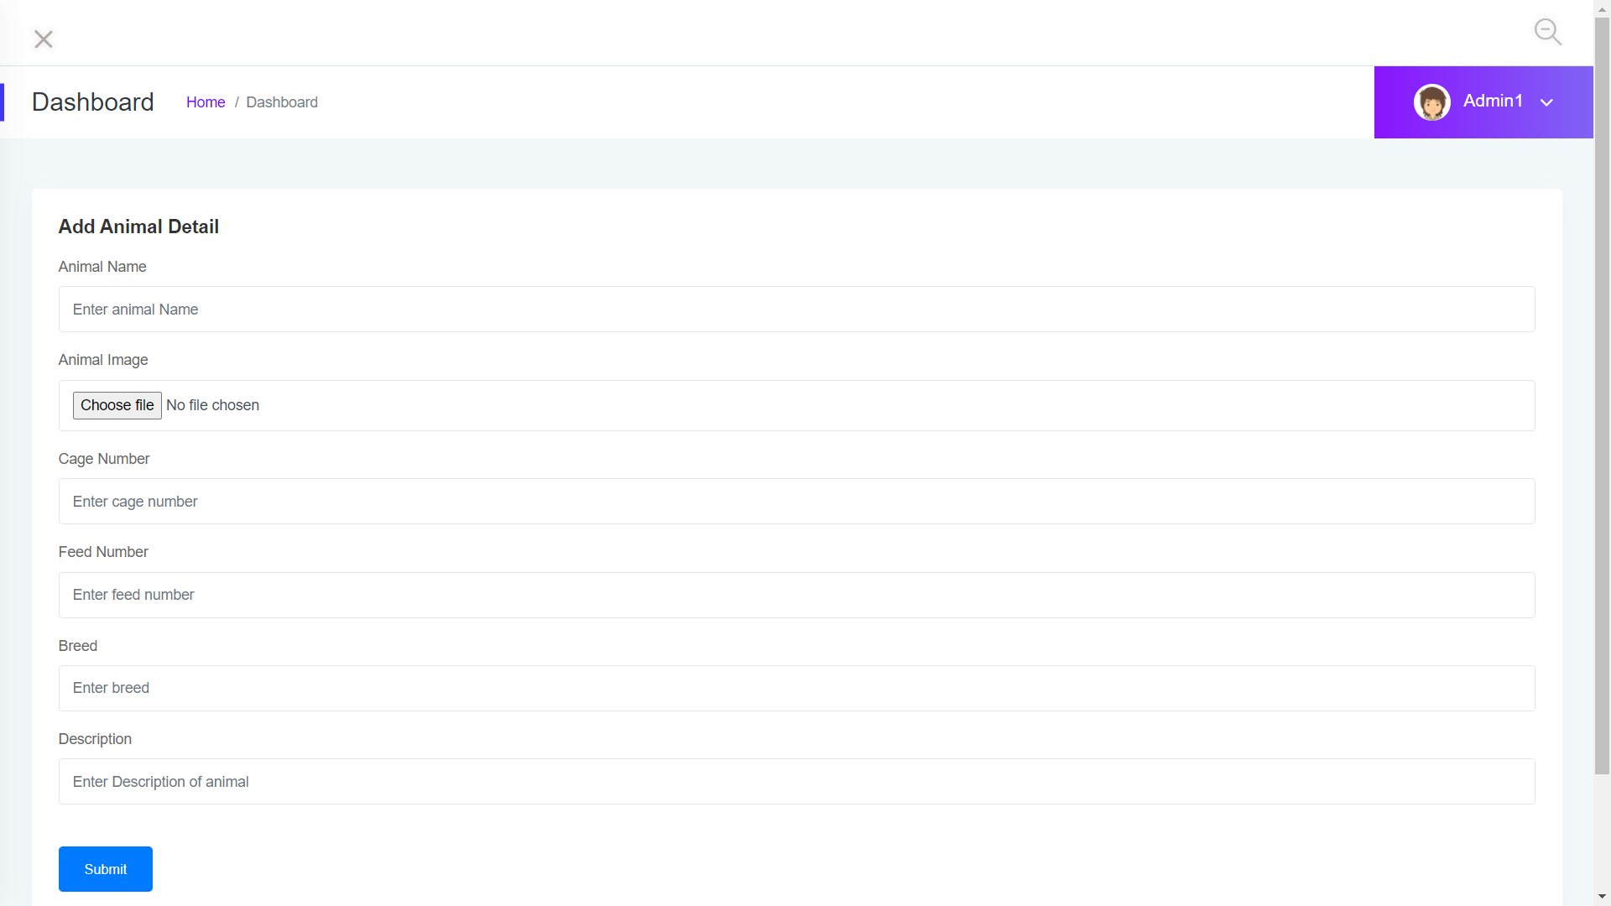
Animal Details Module:
The Animal details module in Zoo management system helps the zoo management to add new animals in the list of animals and manage animals. It helps the management system to know that in which cage the animal has been kept and we get to know which type of breed they belongs to, and on which date they have been brought to the zoo.

Slide 6
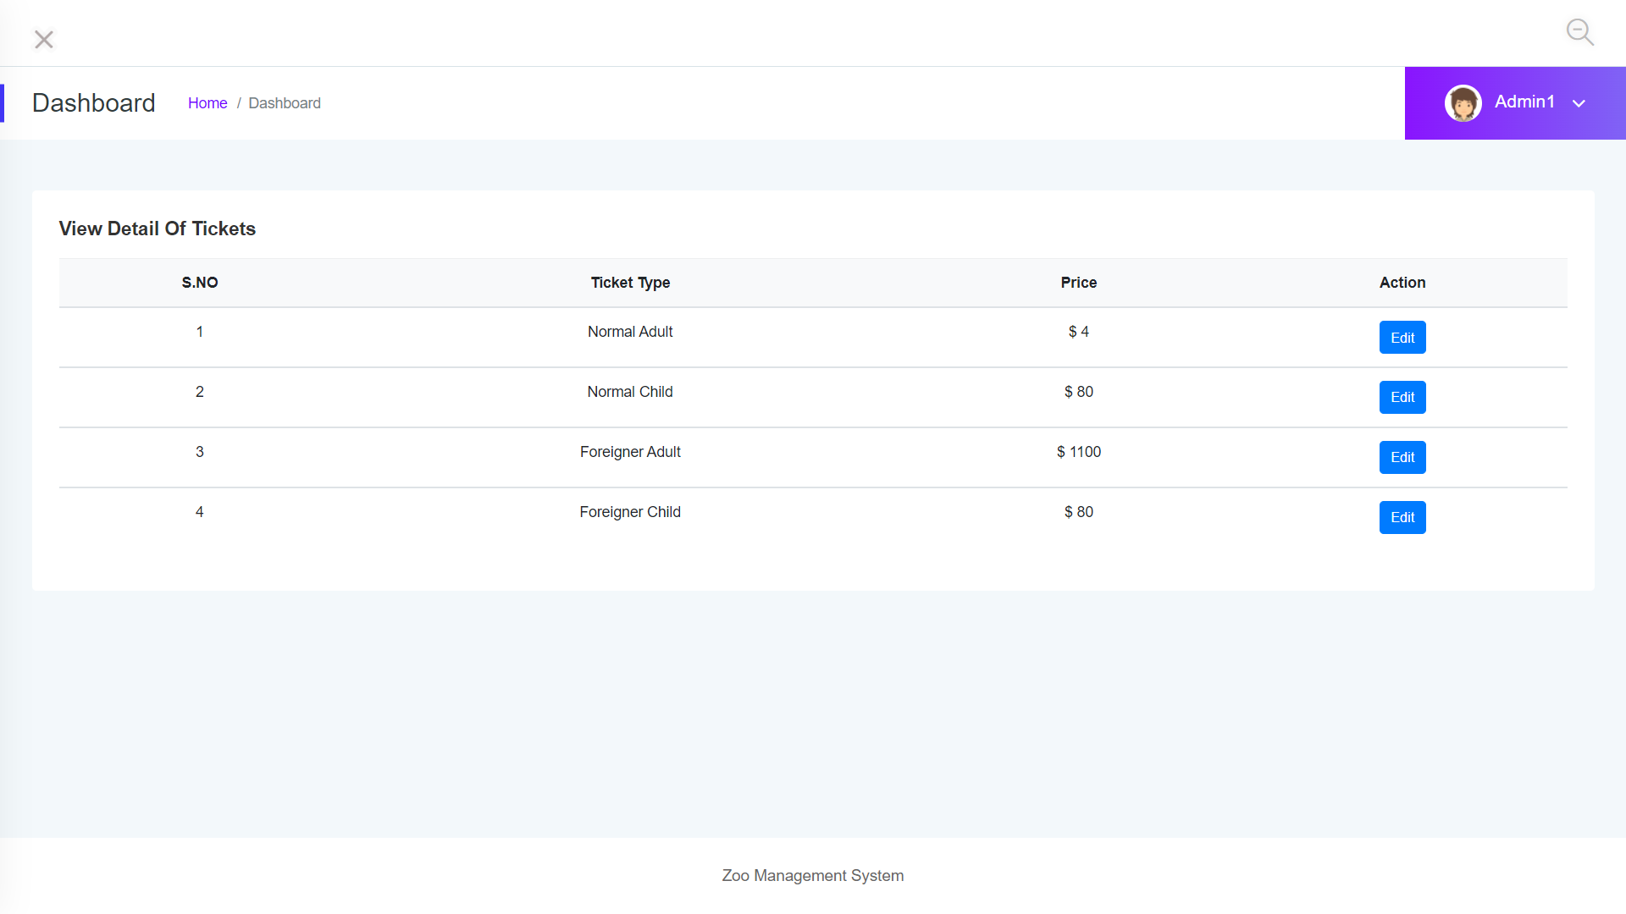
Manage Type Ticket:
This module helps Zoo management System in fixing the prices of the tickets for Normal Adults, Normal Child, Foreigner Adult, Foreigner Child and we can change or update the prices for each type of tickets.

Slide 7
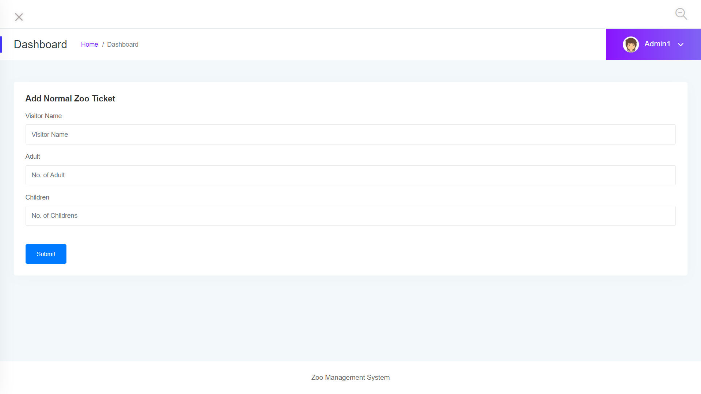
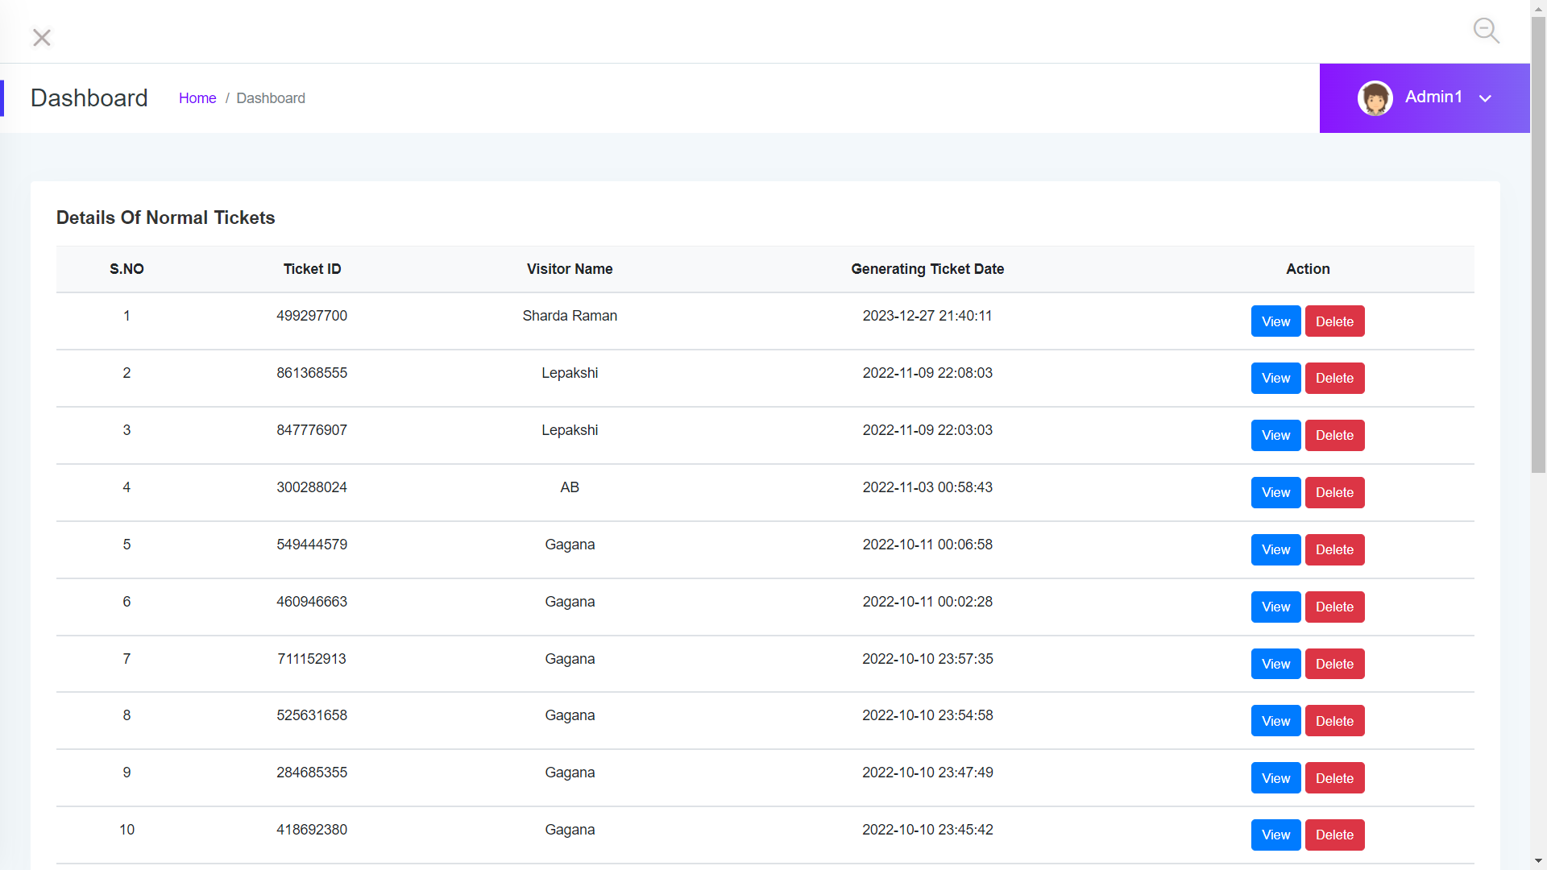
Normal Ticket:
In Normal ticket module we can add persons of our own country. In this module the application will store all the data regarding the ticket buyer and it will generate a random ticket number for each and every ticket. Here we can see the details of the ticket.

Slide 8
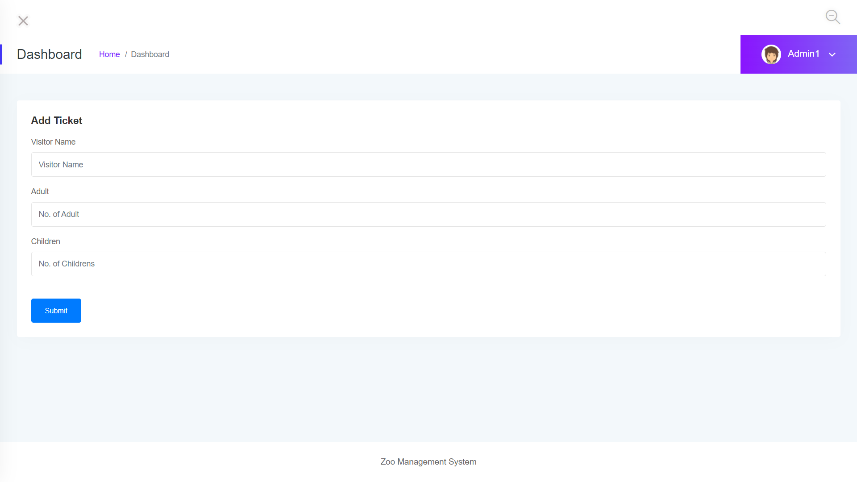
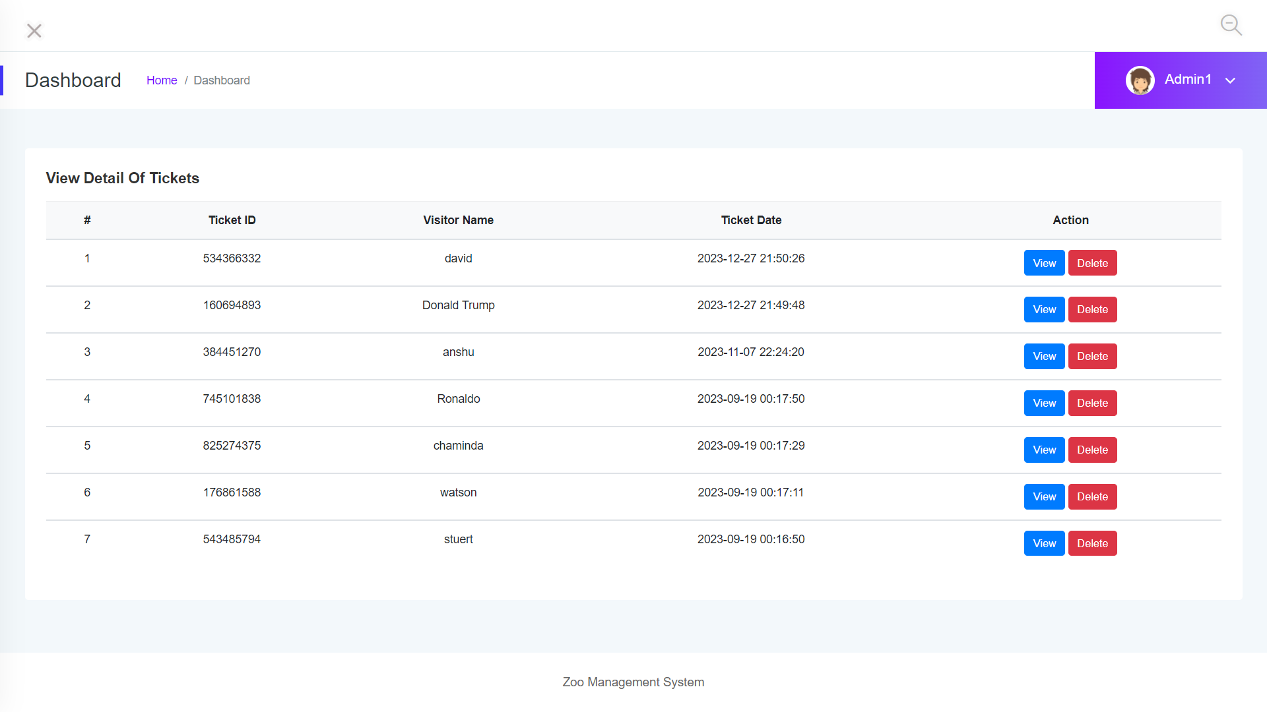
Foreigners Ticket:
In Foreigners ticket module we can add persons of another countries . In this module the application will store all the data regarding the ticket buyer and it will generate a random ticket number for each and every ticket. Here we can see the details of the ticket.

Slide 9
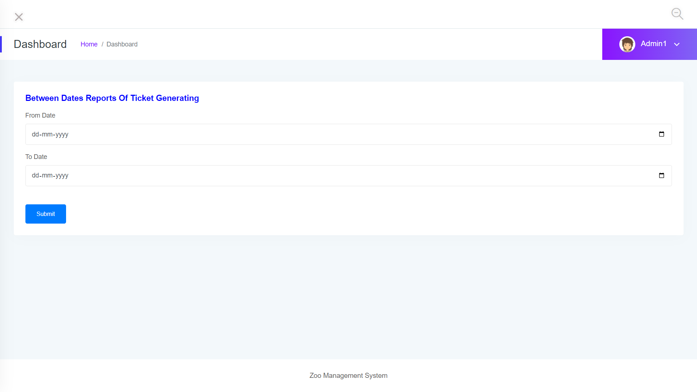
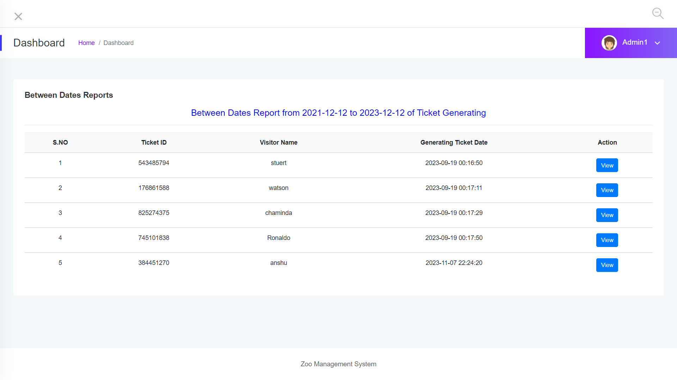
Reports:
Reports Module generates the report which contains details of people who have visited the zoo in a particular range dates. It asks for two dates 1. From Date and 2. To Date.

Slide 10
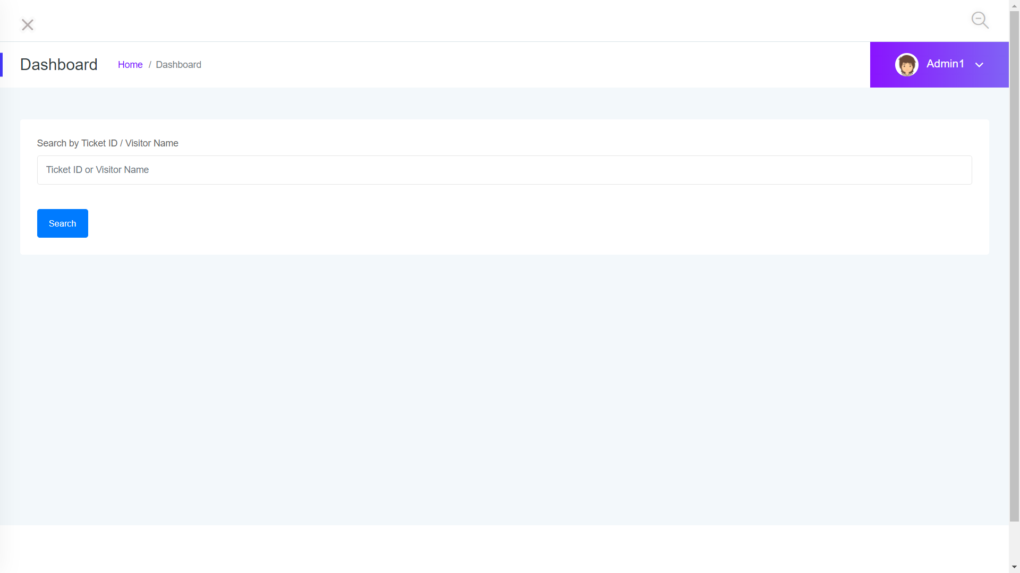
Search Module:
This module generates the report of a individual based on there names and there id’s.

Slide 11
Functional Dependencies:
Add Ticket
Add Animals
Normal
Ticket
Animal
Details
Dash Board
Manage Animals
Manage
Ticket
Search
Add Ticket
Foreigners
Tickets
Manage
Ticket

Slide 12
Effort and Estimation:
User Story Id | User Story Name | Tasks | Test Cases | Story Point | Men power Per Hour | Days
Us-01 | Animal Details | T-01 T-02 | + 25 +04 | 02 01 | 16 8 | 02 Days 01 Day
Us-02 | Manage Type Ticket | T-03 | 02-03 | 01 | 8 | 01 Day
Us-03 | Normal Ticket | T-04 T-05 | 04 02-03 | 01 01 | 8 8 | 1 Day
Us-04 | Foreigners Ticket | T-06 T-07 | 04 02-03 | 01 01 | 8 8 | 1 Day
Us-05 | Reports | T-08 T-09 | 02-03 02-03 | 01 01 | 8 8 | 1 day
Us-06 | Search | T-10 T-11 | 03 03 | 01 01 | 8 8 | 1 Day
Us-07

